Slide 1
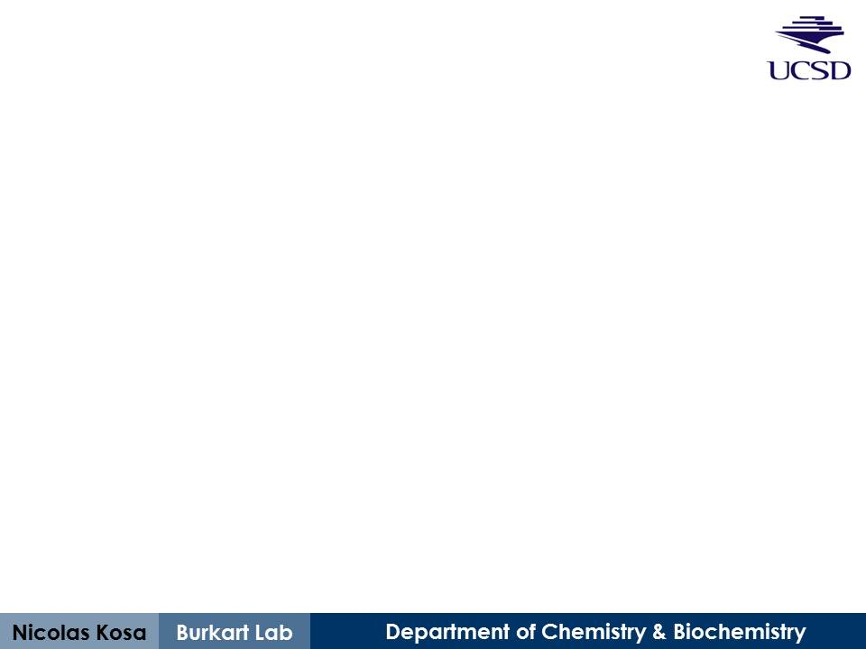
Training Set #1 Reults
Treatment of spot-peptide array with Sfp and PfAcpH/CyAcpH
August 12th, 2013

Slide 2
Basic Procedure
Peptide synthesis (step 0)
Conducted on PEGylated (PEG500) cellulose membrane with Intavis spot-array synthesizer
Sfp Reaction (step 1)
20 μM rhodamine-maleimide-CoA
1 μM Sfp, 2 hours at 37°C
PfAcpH Reaction (step 2)
Utilized membrane post-Sfp reaction
2 μM PfAcpH, 16 hours at 37°C
CyAcpH Reaction (step 3)
Utilized membrane post-PfAcpH reaction
5 μM CyAcpH, 16 hours at 37°C
General
1 M NaCl triple wash post-reaction (reduce non-specific fluorescence)
Typhoon 532 nm excitation / 580 nm emission
All image processing performed in ImageJ (NIH)

Slide 3
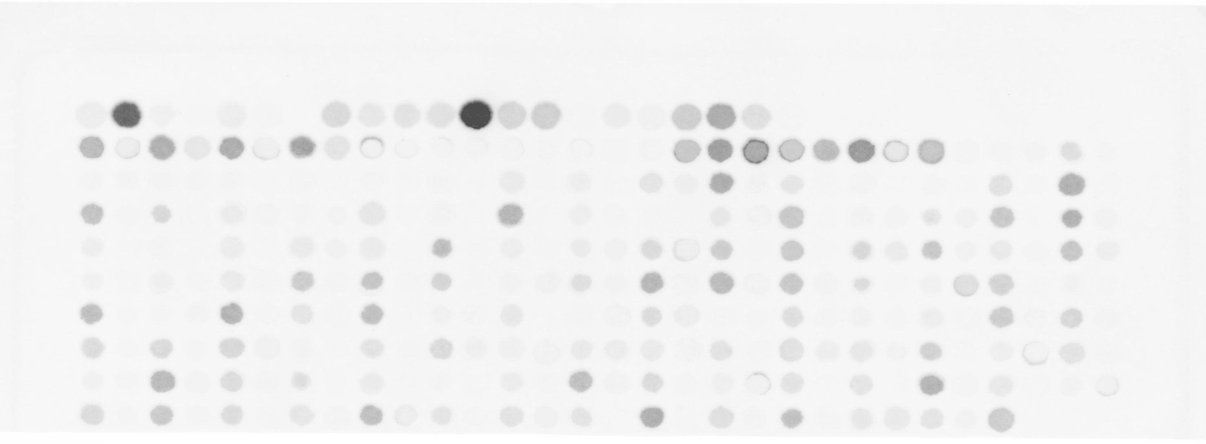
Membrane/Peptide Layout & Files
See file “TS#1A-Row Profile Plots & Consensus_Sfp+PfAcpH+CyAcpH” for profile plots of raw data for each row A, B, C, etc.
See file “TS#1A-Integrated Density_Sfp+PfAcpH.xls” for individual peptide assignments on membrane, as well as integration of each spot’s fluorescence.
These row/column assignments are used for identification in provided files.
 | 1 | 2 | 3 | 4 | 5 | 6 | 7 | 8 | 9 | 10 | 11 | 12 | 13 | 14 | 15 | 16 | 17 | 18 | 19 | 20 | 21 | 22 | 23 | 24 | 25 | 26 | 27 | 28 | 29 | 30
A
B
C
D
E
F
G
H
I
J
All images here are fluorescent, the dark spots appear pink to the naked eye.

Slide 4
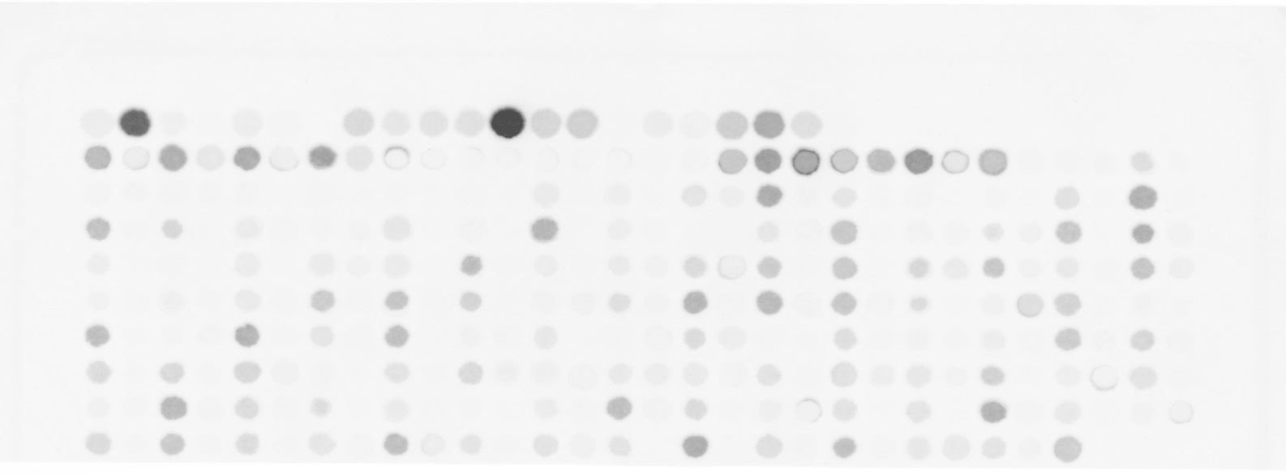
Two image processing methods
Two forms of image processing used
Row “profiles” (Fairly qualitative)
File: “TS#1A-Row Profile Plots…”
Individual spot integration (Probably the most useful)
File: “TS#1A-Integrated Density…”
Spot Integration
#1 #2 #3
etc…

Slide 5
Poly-AA & Initial Processing
First row (A) peptides are polymers of each amino acid (to prime the needle of the synthesizer).
Both poly-Arg and poly-Lys gave very high signal, with Phe, Trp, and Tyr following in signal intensity
Possibly electrostatic interaction with negative rhodamine (R/K) or hydrophobic interaction (F/Y/W)???
Multiple changes (decreases) in fluorescence were detected following PfAcpH.
Upon further treatment with CyAcpH the change in signal was negligible (by profile plot) and was not integrated.
All hits demonstrating a significant decrease in intensity compared to control spots are listed

Slide 6
Prospective Sfp/PfAcpH active peptides
All signals/scores/ranks here are derived from profile plotting for each row
SPOT# | Sfp signal | PfAcpH signal | Pf "Score" | Rank | Sequence
B1 | 17170 | 18681 | -1511 |  | DSLEFIASKLA
B3 | 19922 | 21295 | -1373 |  | DSLEFIASKLAGSGSGSGSG
B5 | 20470 | 21327 | -857 |  | GDSLSWLLRLLN
B7 | 23908 | 22619 | 1289 |  | GDSLSWLLRLLNGSGSGSGS
D27 | 14086 | 10412 | 3674 | 3 | NSASFVEDLGADSLDTVELN
E17 | 9250 | 6181 | 3069 | 8 | NEASFVDDWDADSLDTVELV
E19 | 12593 | 9653 | 2940 | 11 | NSASFVEDLGADSLDTAELV
E23 | 9510 | 6999 | 2511 | 13 | NEASFSDDLGADSLDTVELV
E25 | 13243 | 10088 | 3155 | 7 | NNASFSEDLGADSLDTVELV
E29 | 13879 | 10643 | 3236 | 5 | NSASFVEDYHADSLDTVELV
F7 | 12690 | 10377 | 2313 | 14 | NSASFVEDRGADSLDTVELV
F9 | 14789 | 11052 | 3737 | 2 | NEASFVDDLGADSLDTVELC
F11 | 10524 | 8403 | 2121 | 16 | NSASFVEDQGADSLDTVELV
G21 | 8029 | 5342 | 2687 | 12 | NEASFDDDLGADSLDTVELV
G29 | 9899 | 6726 | 3173 | 6 | NNASFEEDLGADSLDTVELV
H3 | 9918 | 6670 | 3248 | 4 | NEASFGDDLGADSLDTVELV
H5 | 9865 | 7633 | 2232 | 15 | NSASFSEDLGADSLDTLETV
H25 | 11118 | 8117 | 3001 | 10 | NNASFVEDLGADSLDTAELV
J21 | 15879 | 11797 | 4082 | 1 | NRASFSDDLGADSLDTVELV
Controls
Training Set #1 ‘Hits’

Slide 7
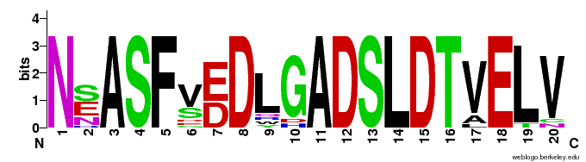
Prospective Sfp/PfAcpH active peptide
Training set prospective ‘active’ peptides display a consensus sequence, depicted below (does not take into account intensity of “hits”)
This sequence does not appear at risk of non-specific signal from poly-Arg/Lys/Phe/Tyr/Trp, although it does have one Phe
The consensus is 100% IDENTICAL TO THE Pseudomonas ACP in the same region
Further activity analysis of this peptide is planned while awaiting next training set.
PfAcpH Consensus Ybbr13
S6
A1
Pseudomonas ACP
N | S | A | S | F | V | E | D | L | G | A | D | S | L | D | T | V | E | L | V
 |  |  |  |  |  |  |  |  |  |  | D | S | L | E | F | I | A | S | K | L | A
 |  |  |  |  |  |  |  |  |  | G | D | S | L | S | W | L | L | R | L | L | N
 |  |  |  |  |  |  |  |  |  | G | D | S | L | D | M | L | E | W | S | L | M
N | S | A | S | F | V | E | D | L | G | A | D | S | L | D | T | V | E | L | V | M | A

Slide 8
More Discussion
This result implies AcpH preference for its native ACP
However, this PfAcpH consensus peptide could likely be optimized, as the consensus did not necessarily provide the highest signal from the panel
Perhaps inclusion/variation of the Cyanothece PCC 7822 ACP sequence in the next panel could yield a similar active peptide for CyAcpH
Cyanothece PCC 7822 AcpP: MTNIMNEEIFEKVKKIVVDQLDVEPEAVTPDASFANDLNADSLDTVELVMALEEEFEIEIPDEEAEKLDTVGKAVAHISEKKK
Peptide Consensus Ybbr13
S6
A1
Pseudomonas ACP
Cyanothece ACP
N | S | A | S | F | V | E | D | L | G | A | D | S | L | D | T | V | E | L | V
 |  |  |  |  |  |  |  |  |  |  | D | S | L | E | F | I | A | S | K | L | A
 |  |  |  |  |  |  |  |  |  | G | D | S | L | S | W | L | L | R | L | L | N
 |  |  |  |  |  |  |  |  |  | G | D | S | L | D | M | L | E | W | S | L | M
N | S | A | S | F | V | E | D | L | G | A | D | S | L | D | T | V | E | L | V | M | A
P | D | A | S | F | A | N | D | L | N | A | D | S | L | D | T | V | E | L | V | M | A

Slide 9
Raw Images

Slide 10
Image 1: Sfp/mCoA Treatment
 | 1 | 2 | 3 | 4 | 5 | 6 | 7 | 8 | 9 | 10 | 11 | 12 | 13 | 14 | 15 | 16 | 17 | 18 | 19 | 20 | 21 | 22 | 23 | 24 | 25 | 26 | 27 | 28 | 29 | 30
A
B
C
D
E
F
G
H
I
J
Notes:
The acyl carrier protein hydrolase (AcpH) from Pseudomonas aeruginosa is able to remove a variety of phosphopantetheine analogs from an intact carrier protein, but does not sufficiently perform the same reaction on the short Ybbr peptide.

Slide 11
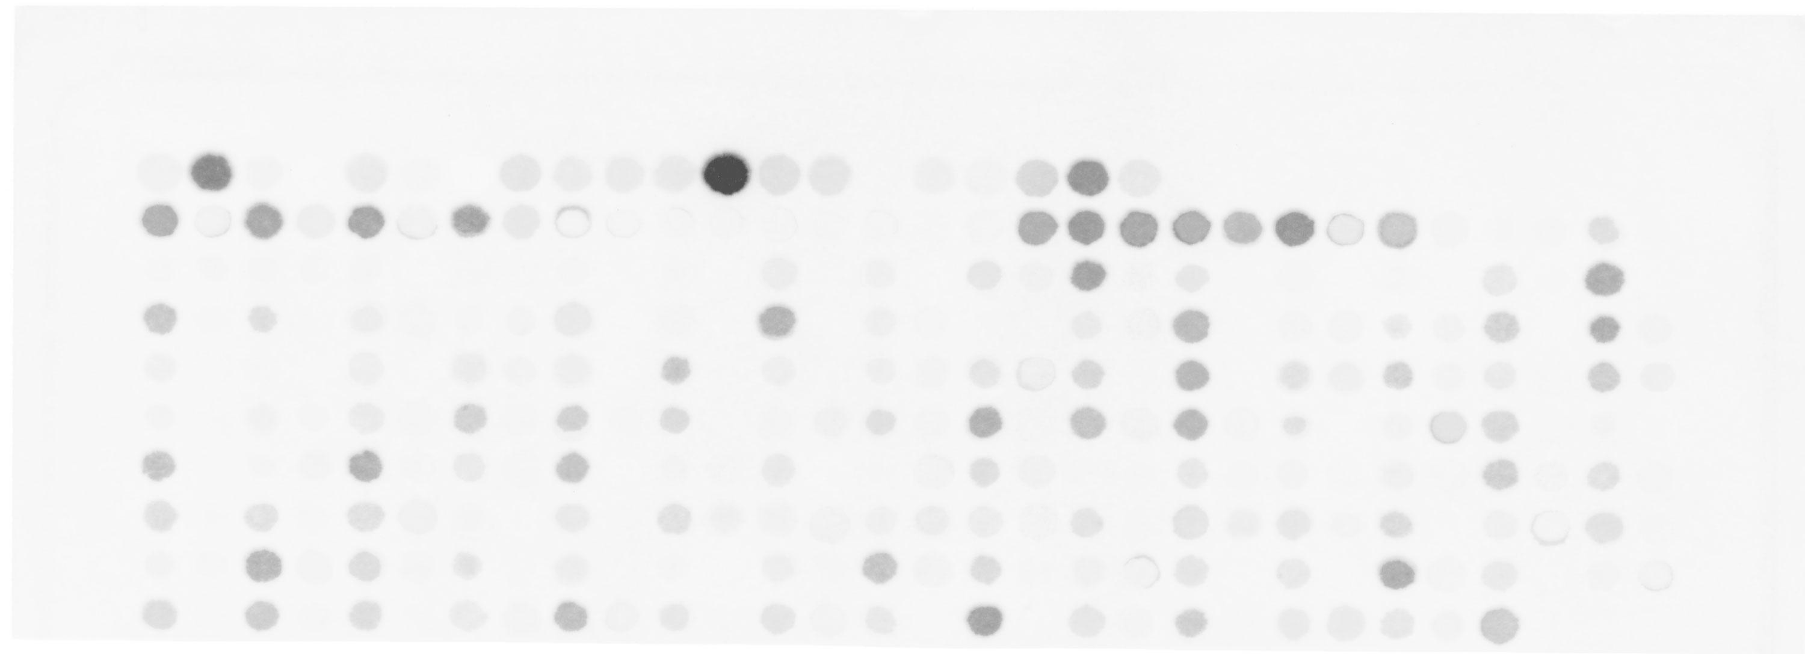
Image 2: PfAcpH Treatment
 | 1 | 2 | 3 | 4 | 5 | 6 | 7 | 8 | 9 | 10 | 11 | 12 | 13 | 14 | 15 | 16 | 17 | 18 | 19 | 20 | 21 | 22 | 23 | 24 | 25 | 26 | 27 | 28 | 29 | 30
A
B
C
D
E
F
G
H
I
J
Notes:
The acyl carrier protein hydrolase (AcpH) from Pseudomonas aeruginosa is able to remove a variety of phosphopantetheine analogs from an intact carrier protein, but does not sufficiently perform the same reaction on the short Ybbr peptide.

Slide 12
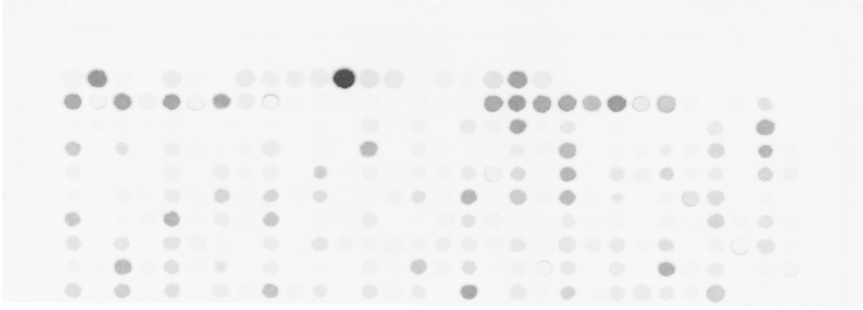
Image 3: CyAcpH Treatment
 | 1 | 2 | 3 | 4 | 5 | 6 | 7 | 8 | 9 | 10 | 11 | 12 | 13 | 14 | 15 | 16 | 17 | 18 | 19 | 20 | 21 | 22 | 23 | 24 | 25 | 26 | 27 | 28 | 29 | 30
A
B
C
D
E
F
G
H
I
J

